Slide 1
Upgrade and Migration

Slide 2
Table of Contents
AGENDA
Need for Upgrade / Migration
Difference between Upgrades and Migrations
Generation of Stack File
Upgrade / Migration Tools
Maintenance Planner
PAM
Upgrade Types and Strategies

Slide 3

Need for Upgrade / Migration
UPGRADE:
Since technology and businesses evolve, All companies need to maintain a technological infrastructure that can support that change. This is the major reason why companies should undertake a technical upgrade of their SAP system.
Migration:
A migration refers to the process of replaying actions from one system into another system.
EX: Migration means switching from sql(or any) to sybase(or any)…etc

Slide 4
Difference between Upgrades and Migrations
upgrade only upgrades the software to the latest version and the new functionalities that come with the new version are not activated or implemented.
Whereas in a functional upgrade, the functionalities offered by the new SAP version are also implemented in addition to technically upgrading the software.
Migration is the process of replicating applications from one product in another product EX: Migration means switching from sql(or any) to sybase(or any), Cloud migration…etc

Slide 5
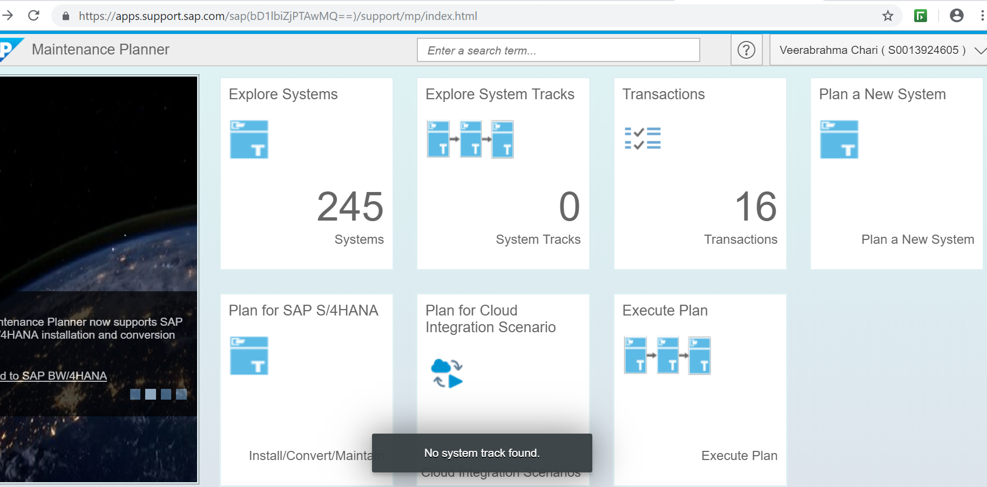
Generation of Stack File :
Open Maintenance Planner from below URL given in below screenshot:
https://apps.support.sap.com/sap/support/mp
·

Slide 6
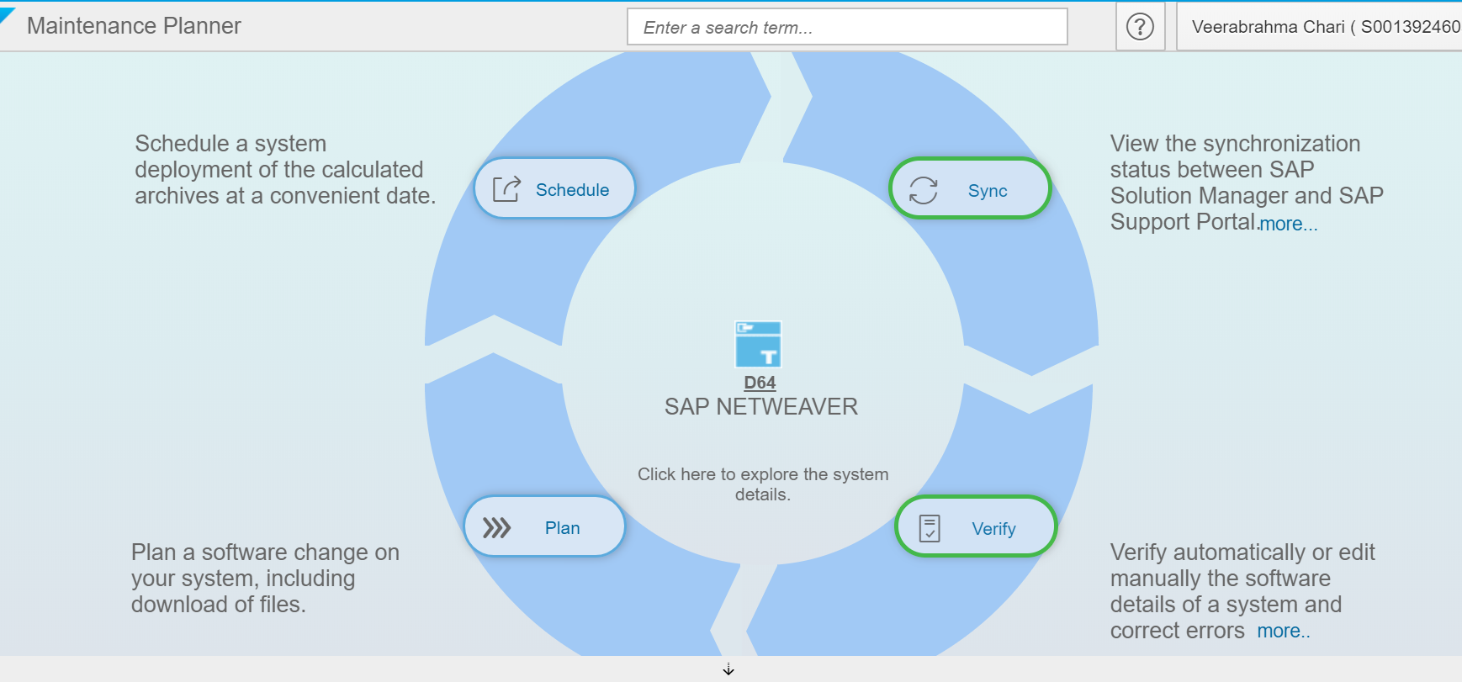
:
Click on Plan to generate Stack File:
Below example is for generate stack file for SAP NetWeaver 7.4.
Selected :Upgrade SAP NetWeaver.
Selected :SAP NetWeaver 7.4.
Selected: Stack dependent and Independent Files.
Details of overall selected components.
Download Stack File.

Slide 7
Upgrade / Migration Tools
SUM is now offered in two Scenarios
SUM 1.0 SP 23
SUM 2.0 SP 04
Scenarios 1:
Software Update Manager 1.0 SP23:
The Software Update Manager (SUM) is the tool for various system maintenance procedures such as:
Release upgrades (major release change)
System updates (EHP installation)
Support Packages (SPs) / Support Package Stacks applications
Java patches applications
Corrections of installed software information
SUM 1.0 is always used if the source system is either a dual-stack system, or a Java stack.
SUM 1.0 is used for ABAP stack if target is based on BASIS 7.40 or lower

Slide 8
Scenarios 2:
Software Update Manager 2.0 SP04:
The Software Update Manager (SUM) is the tool for various system maintenance procedures such as:
You want to update or upgrade an existing SAP NetWeaver AS ABAP based system using the Software Update Manager tool with version 2.0 SP04.
Database migration also we can use this Software Update Manager tool with version 2.0 SP04 and SUM 2.0 is used for ABAP single stacks, targeting systems based on BASIS 7.50 and higher (exception: SUM 2.0 is used for ZDO even if target is BASIS 7.40 or lower).

Slide 9
Database Migration option(DMO) :
DMO is alternative approach to classical migration (heterogenous system copy)
System update, Unicode Conversion and database migration combined in one tool, one downtime
Migration steps are simplified: consultant certification not required
Business Downtime is reduced
SAP’s recommendation for migration target SAP HANA database: use DMO, if possible (see https://blogs.sap.com/2017/11/22/comparing-sap-migration-procedures-to-sap-hana-database/ )
DMO: Business Case Upgrade and migration in a combined procedure reduces TCO and risks Combined procedure needs only one maintenance phase (not two)
Reduces business downtime (TCO), less regression tests necessary In-place migration keeps application server and System-ID stable
Low impact on system landscape: only database server is new Original database is kept, can be reactivated as fallback
Reduces risk, no restore required, more time for testing before cutover No necessity for big export file share during migration
Direct migration transfer without large dump files

Slide 10
Software Provisioning Manager (SWPM)
To Install, copy, transform, split, rename, and uninstall products based on SAP NetWeaver AS ABAP and AS Java.

Slide 11
Maintenance Planner:
It is required to generate the XML file, For this need a Solution manager system.
If you are using solution manager 7.1, There Maintenance Optimizer (MOpz) available.
If you are using solution manager 7.2, There Maintenance Planner (MP) available.
Maintenance Planner (MP) URL : https://apps.support.sap.com/sap/support/mp.
Before installation, Download and unpack the latest version of Software Provisioning Manager(SWPM).
Downloading Installation Media it include SAP Installation , DB Installation, Latest kernel…etc.
Download the media in to the download directory & Unpack all into the same directory.

Slide 12
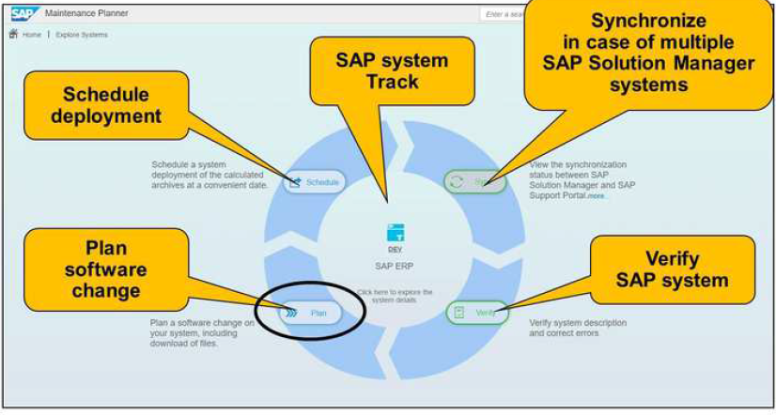

Slide 13
Product Availability Matrix (PAM):
PAM regularly publish information about SAP software releases: release types, maintenance durations, planned availability, and upgrade paths. The PAM also offers information about platform availability, including database platform and operating systems.
PAM URL:
https://apps.support.sap.com/sap(bD1lbiZjPTAwMQ==)/support/pam/pam.html?smpsrv=https%3a%2f%2fwebsmp106.sap-ag.de#ts=0

Slide 14
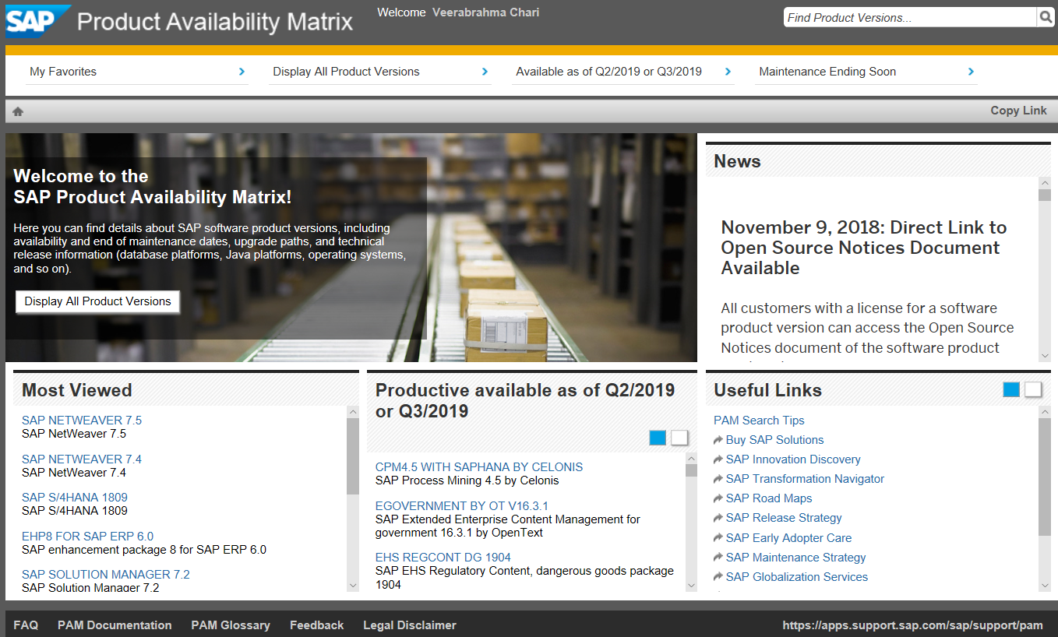
Simple view of PAM

Slide 15
Upgrade Types and Strategies
SP Upgrade :
SAP collects all the corrections in one place and this collection is called SUPPORT PACKAGE. This support package also includes enhancements to earlier versions of SAP.
SPAM/SAINT Update contains updates and improvements to Support Package Manager (SPAM) and Add-On Installation Tool (SAINT). There is always one SPAM update for each release. SPAM/SAINT update is mandatory before any support package upgrade
Stack Upgrade:
SAP recommends the application of support package stacks at least once a year so that all corrections can be implemented. To optimize quality

Slide 16
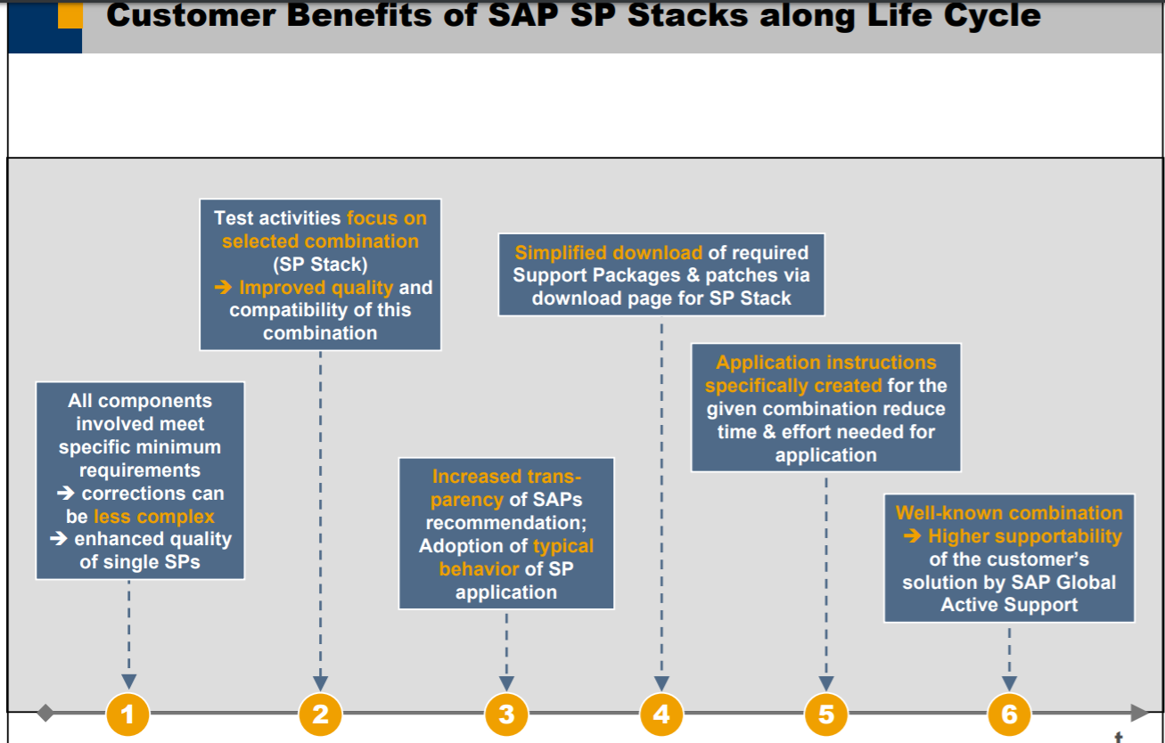
Customer benefit of the Stack Upgrade :

Slide 17
It has become evident that the majority of customers perform a planned maintenance for each productively used SAP application between once and four times a year. This usually affects all components of the given SAP application.
The actual frequency of a planned maintenance however depends on many factors, like:
The specific situation at customer side (e.g. projects, productive status, ...) .
The SAP application itself (e.g. technical conditions, legal changes, ...) .
The advantage of already running on the latest Support Package or patch level, especially when SAP support is needed .
The risk estimation of operating with already known errors (hence incurring unnecessary costs or having to react at short notice) .
The estimated costs of a planned maintenance .

Slide 18
EHP Upgrade
Enhancement Package upgrade is moving from one enhancement package release to another for an SAP solution. For example, EHP upgrade from SAP ERP 6.0 EHP3 to ERP 6.0 EHP5
By using SUM tool we can do the EHP upgrade.

Slide 19
Q & A

